Slide 1
Dairy Farm Shop Management System
Yogeshwar Manerikar
1928

Slide 2
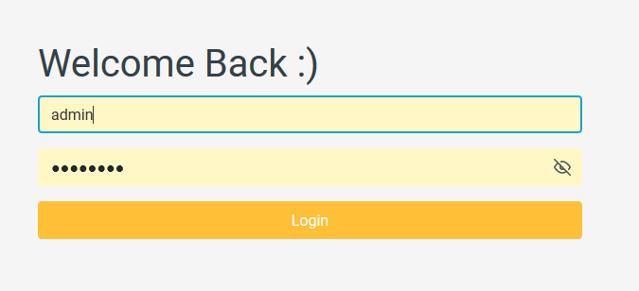
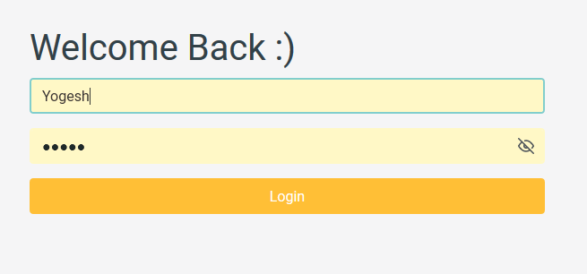
Login part
Admin
Staff

Slide 3
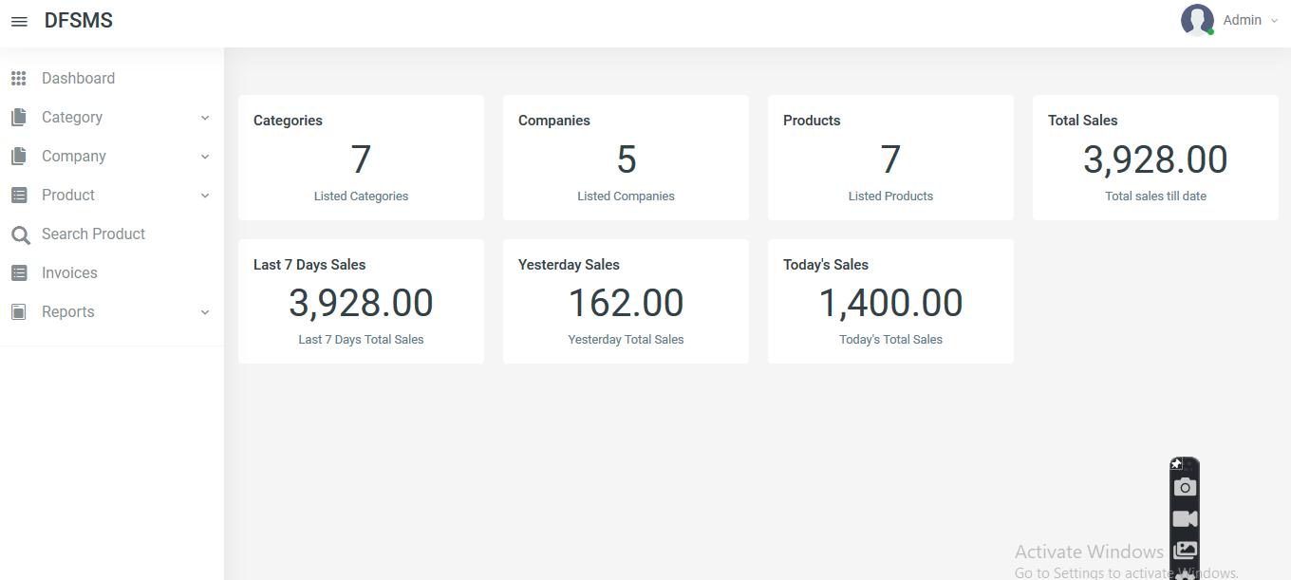
Dashboard

Slide 4
Dashboard

Slide 5
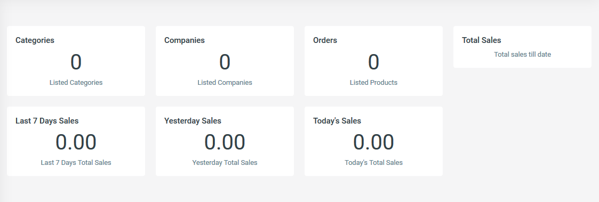
Reports

Slide 6
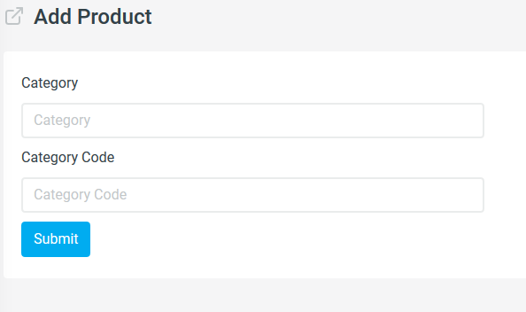
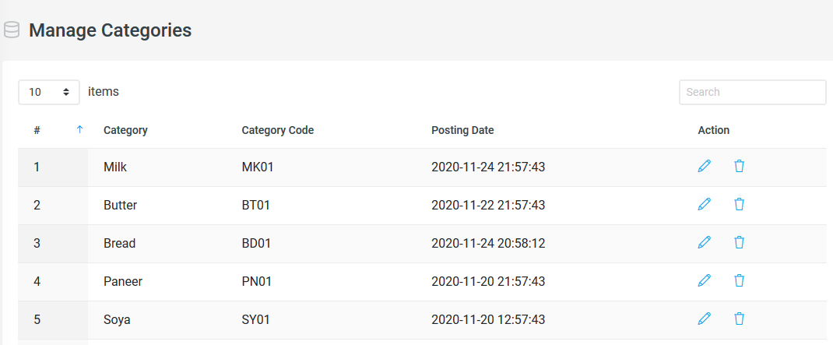
Category
Add
Manage

Slide 7
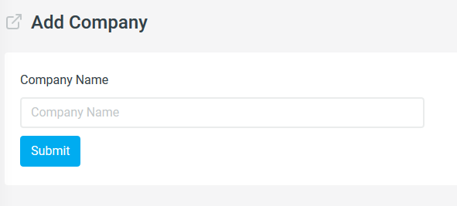
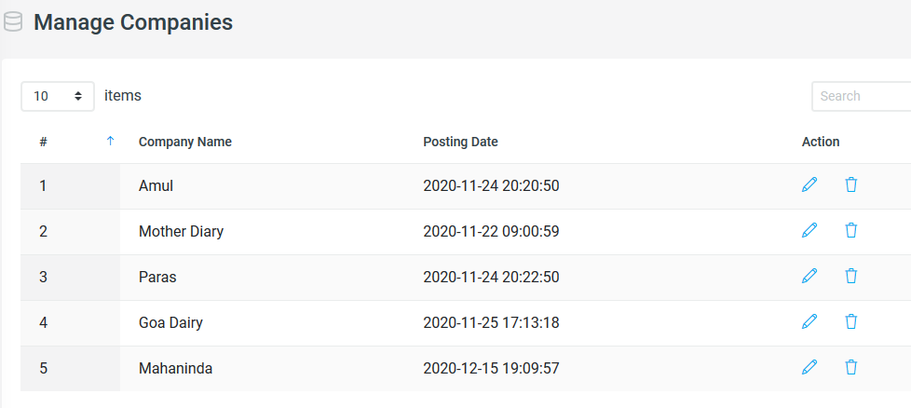
Company
Add
Manage

Slide 8
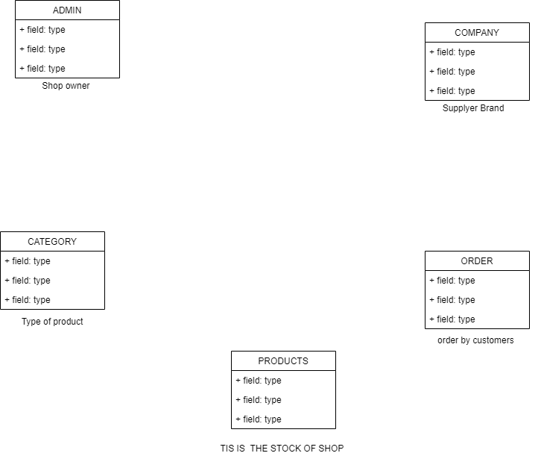

Slide 9
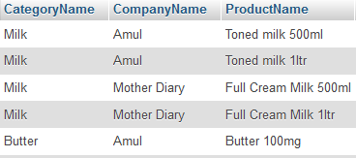
IDEA
Milk
Category
Goa Dairy
Company
Customer Taniya
Orders

Slide 11
THANK YOU !!

